Slide 1

Advanced lab: Using ChatGPT to write Powershell Automation
By Eric Nielsen

Slide 2



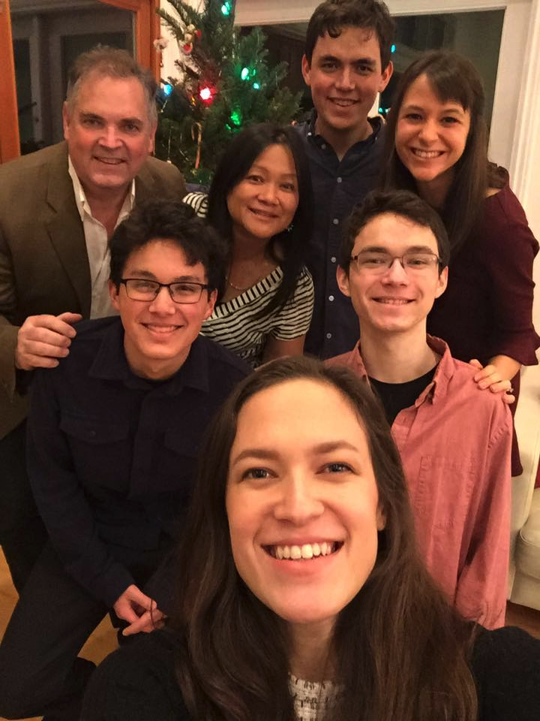
@ericnipro
“Join VMware{code} @comminty.broadcom.com”
University of Florida; Computer Science & Marketing “85”
Stanford: Graduate Classes in Engineering
Out of College: “IBM ESD, PC/XT/AT” Business Apps Group
Companies: “Gould Electronics, Kodak, Pepsi Co, Sun Microsystems
Consulting: US Navy, Australian Navy, Interactive Systems, others.
Founded: BigAdmin, Flash Archive “flar –cvf”, vExpert, VMware{code}
For fun
“Bulletin Boards for sharing “ 1 upload for 10 downloads
Got my first SCO Unix box on a “6MHz IBM AT” first “root” password
“UUCP to Universtiy of Miami” for my own email feed.
Started learning electronics and have never looked back
Married, w/four children, “My oldest is a hardware engineer at Roku”
Part of the “Any Device” Story for VMware Cloud-to-Edge.
Notes:
This is a picture of a SolidRun ClearCloud 8k (https://www.solid-run.com/product/SRM8040S00D04GE008G00CE), with a Marvell Armada A8040 SoC, which has a quad Cortex-A72. This was the platform demonstrated at Vegas (Wind Turbine demo during the keynote) and Barcelona.

Slide 3
Summary of this session
Software Languages
Understanding User Rolls
Exercising ChatGPT as a Software Dev.

Slide 4
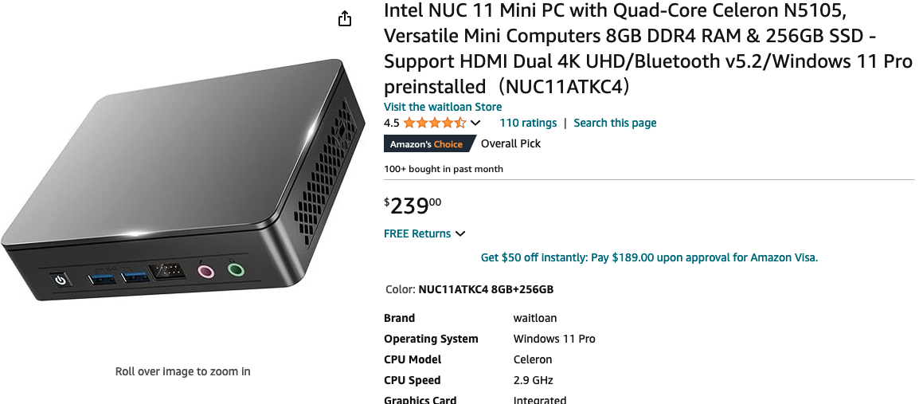
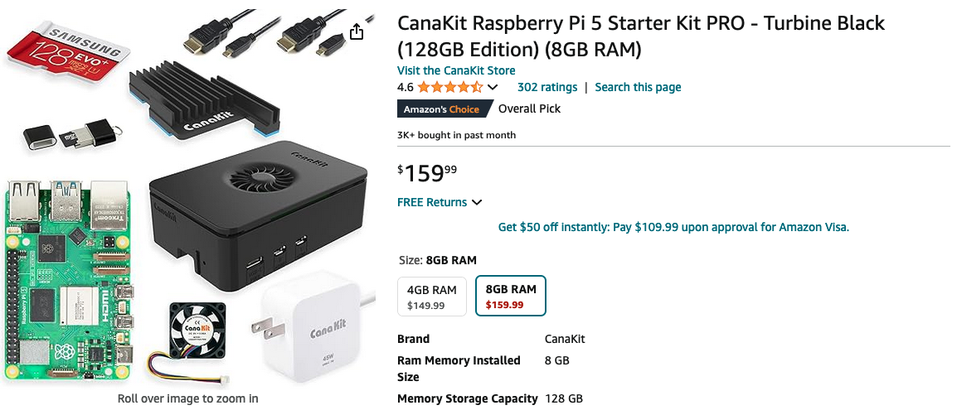
The Hardware for this Lab
Intel NUC/Clone with Celeron X86 CPU
16/32/64 Gig of Memory, No fan, Dual HDMI, Wifi USB Ports
Can Run ESX with USB Ethernet Dongle
256/500 Gig SSD
1080p Display (115.00) , Keyboard, Mouse
Why: <280.00 for a quiet home lab machine
Portable, one entire table fits in two backpacks (No shipping)
Community setup, no event labor required.
More versatile than a Raspberry PI 4/5

Slide 5
Expertise not required
With ChatGPT anyone can learn to write code with Chat GPT
You do not need to be a software engineer – although it helps

Slide 6
Lets get Started!
Login to Existing ChatGPT Account
If this is your first time using ChatGPT, we recommend that you attend the Introduction to ChatGPT session

Slide 7
Software Languages
using basic, write a program that prints Hello World on the screen
ChatGPT will write in just about any software language.
Lets give it a try. In the prompt write “Using basic write a program that prints "Hello World" onto the screen”

Slide 8
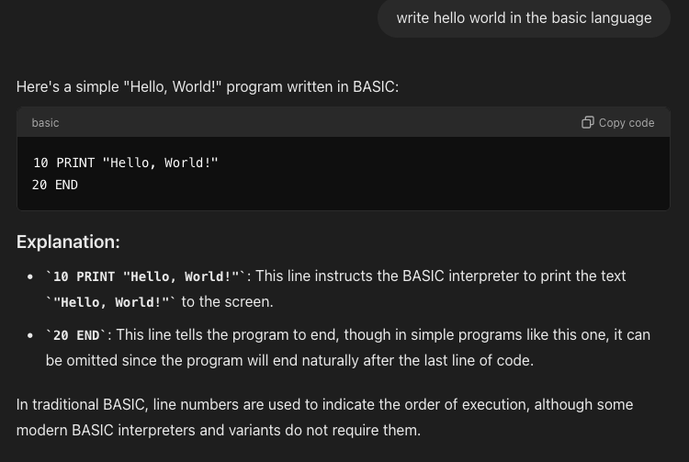
Basic – Hello World
Lets take a moment and review the ChatGPT IO
The request to ChatGPT is called the Prompt.
You will get some explanation of what the results will be
You will get a Code Block that has a Copy Code button in the upper right Corner that can be used to copy and paste the results
You will get an explanation of the above code

Slide 9
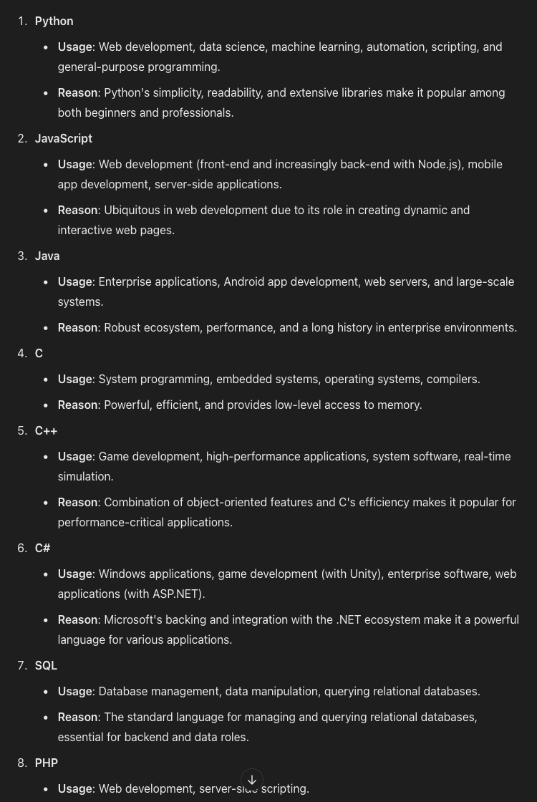
Software Languages
In the Room, what are the common languages that you write in?

Slide 10
Lab #1
Have the AI write Hello world in each of these Languages
Python
Javascript
Java
C
C++
C#
TypeScript
Go (Golang)
Don’t forget that you can request the AI to convert one language to another. For example “rewrite this code in [Java]”

Slide 11
User Rolls and Modifications
When having the AI help you write code, you should be specific as to what Roll you want the AI to write in. Further, ask the AI to add other modifications
Write the code as a beginner or as an expert.
Follow best coding practices for the language of choice
Explain how the code works
Document the Code

Slide 12
Lab #2.
Ask the AI to rewrite the Hello World with each and then all of these modifications: Write the code as a beginner or as an expert.
Follow best coding practices for the language of choice
Explain how the code works
Document the Code
How did the code change

Slide 13

ChatGPT – PowerCLi Intro
Get-VM | Select-Object Name, PowerState, NumCpu, MemoryMB, VMHost, @{N="IP Address";E={@($_.guest.ipaddress)}}
Get-VM -Name "VM1","VM2","VM3" | Start-VM
$sourceVM = Get-VM -Name "SourceVM"
$targetVMName = "CloneVM”
$targetDatastore = Get-Datastore -Name "Datastore1"
$targetFolder = Get-Folder -Name "TargetFolder"
$targetHost = Get-VMHost -Name "ESXiHost1" New-VM -Name $targetVMName -VM
$sourceVM -VMHost $targetHost -Datastore $targetDatastore -Location $targetFolder
Get-VM | Select Name, @{N="Tools Status";E={$_.ExtensionData.Guest.ToolsStatus}}
$vm = Get-VM -Name "VMName"
$adapter = Get-NetworkAdapter -VM $vm
Set-NetworkAdapter -NetworkAdapter $adapter -NetworkName "NewNetwork" -Confirm:$false
Get-VM -Name "VMName" | New-Snapshot -Name "SnapshotName" -Description "Snapshot before upgrade”
Get-VM | Select Name,
@{N="CPU Usage";E={(Get-Stat -Entity $_ -Stat cpu.usage.average -Realtime -MaxSamples 1).Value}},
@{N="Memory Usage";E={(Get-Stat -Entity $_ -Stat mem.usage.average -Realtime -MaxSamples 1).Value}}
Get-VM | Select Name,
@{N="Provisioned Space (GB)";E={[math]::round($_.ProvisionedSpaceGB,2)}},
@{N="Used Space (GB)";E={[math]::round($_.UsedSpaceGB,2)}}
$vm = Get-VM -Name "VMName"
$targetHost = Get-VMHost -Name "TargetHost"
Move-VM -VM $vm -Destination $targetHost
10. $vm = Get-VM -Name "NewVM"
$spec = New-OSCustomizationSpec -Name "CustomSpec" -Domain "domain.local" -ChangeSid
Set-VM -VM $vm -OSCustomizationSpec $spec
The answer will be typical:
1. VM Inventory Report
2. Power On/Off Multiple VMs
3. Clone a VM
4. VMware Tools Status Check
5. Change VM Network Adapter
6. Snapshot Management
7. VM Performance Metrics Report
8. VM Disk Space Usage Report
9. Migrate VM to Another Host
10. VM Guest OS Customization
This does not however, make you a programmer ! …. Yet…

Slide 14
Lab #3.
Install PowerCLI and Connect to ESX

Slide 15
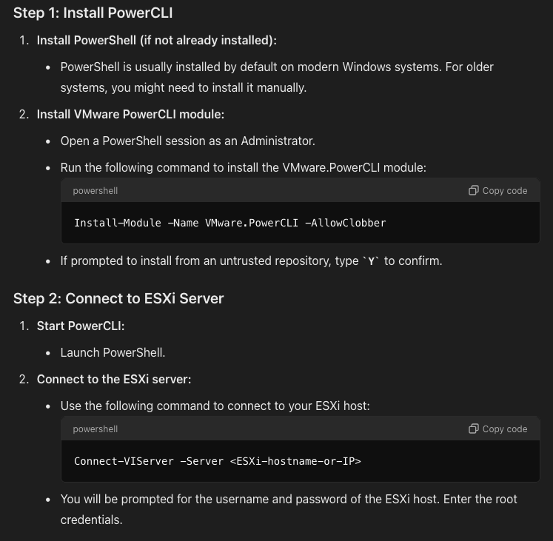

ChatGPT – PowerCLi Intro
It’s always good to understand how to enable your environment.
Simply ask ChatGPT
Notes:
You must run PowerShell as Admin
(Search Powershell and right click and “Run as admin” to launch Powershell as Admin)
You must Enable Powershell Security
> Import-Module VMware.VimAutomation.Core
> Set-ExecutionPolicy –ExecutionPolicy RemoteSigned
> Set-PowerCLIConfiguration –InvalidCertificateaction Ignore –Confirm:$false
Connect-VIServer –Server 72.172.185.171
Name Port User
--------- ----- ------
72.172.185.171 443 root

Slide 16
Simple PowerCLI Results
> Connect-VIServer –Server 72.172.185.171
Name Port User
--------- ------- -------
72.172.185.171 443 root
> Get-VMHost
Name ConnectionState PowerState NumCpu CpuUsageMhz CpuTotalMhz MemoryUsageGB MemoryTotalGB Version
--------- ----------------------- ---------------- ------------- ------------------- ----------------- ----------------------- --------------------- ----------
72.172.185.171 Connected PoweredOn 2 275 3798 7.625 7.999 8.02
> Get-VM
Name PowerState Num CPUs MemoryGB
--------- ---------------- --------------- ----------------
CodeLabTable1 Powered On 1 2.000
CodeLabTable2 Powered On 2 2.000
CodeLabTable3 Powered On 3 2.000
CodeLabTable4 Powered On 4 2.000

Slide 17
Lab #3.
Write a Basic PowerShell Program

Slide 18

ChatGPT – PowerCLi Intro
# Connect to vCenter Server
$vcenterServer = "your_vcenter_server" # Replace with your vCenter Server
$credential = Get-Credential
Connect-VIServer -Server $vcenterServer -Credential $credential
# Get all VMs
$vms = Get-VM
# Filter VMs that are powered off
$poweredOffVMs = $vms | Where-Object { $_.PowerState -eq "PoweredOff" }
# Power on each VM that is powered off
foreach ($vm in $poweredOffVMs) {
Write-Host "Powering on VM: $($vm.Name)"
Start-VM -VM $vm
}
# Disconnect from vCenter Server
Disconnect-VIServer -Confirm:$false
This is looking more like an App:
Programing is looking now looking more and more like knowing how to use ChatGPT
But,…. can we make this more complex..
See Lab3.ps1 for the source saved in your directory

Slide 19
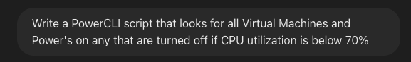
ChatGPT – PowerCLi Intro
# Connect to the vCenter server
Connect-VIServer -Server "YourVCenterServer"
# Set the CPU threshold percentage
$cpuThreshold = 70
# Get all hosts and their CPU usage
$hosts = Get-VMHost | Select Name, @{Name="CpuUsage";Expression={($_.CpuUsageMhz / $_.CpuTotalMhz) * 100}}
# Iterate over each host
foreach ($host in $hosts) {
# Check if the host's CPU usage is below the threshold
if ($host.CpuUsage -lt $cpuThreshold) {
Write-Host "Host $($host.Name) is under the CPU threshold with $($host.CpuUsage)% CPU usage."
# Get all VMs on this host that are powered off
$vms = Get-VM -Location $host.Name | Where-Object {$_.PowerState -eq "PoweredOff"}
# Power on each VM that is powered off
foreach ($vm in $vms) {
Write-Host "Powering on VM: $($vm.Name)"
Start-VM -VM $vm
}
} else {
Write-Host "Host $($host.Name) is over the CPU threshold with $($host.CpuUsage)% CPU usage.
No VMs will be powered on.”
}
}
# Disconnect from the vCenter server
Disconnect-VIServer -Confirm:$false
Can you make the next program:
1. Error checking ?
2. Time of Day ?
3. Results Table
4. Email transaction?
5. Log results

Slide 20
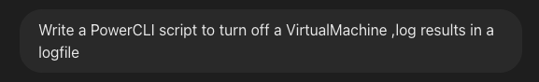
ChatGPT – PowerCLi Intro
# Set variables
$vCenterServer = "your_vcenter_server"
$vmName = "your_vm_name"
$logFile = "C:\path\to\logfile.txt"
# Function to log messages
function Log-Message {
param (
[string]$message
)
$timestamp = Get-Date -Format "yyyy-MM-dd HH:mm:ss"
$logEntry = "$timestamp - $message"
Add-Content -Path $logFile -Value $logEntry
}
# Connect to vCenter Server
try {
Connect-VIServer -Server $vCenterServer -WarningAction Stop
Log-Message "Connected to vCenter Server $vCenterServer."
} catch {
Log-Message "Failed to connect to vCenter Server $vCenterServer. Error: $_"
exit
}
# Get the virtual machine
$vm = Get-VM -Name $vmName -ErrorAction SilentlyContinue
if ($vm -eq $null) {
Log-Message "Virtual machine '$vmName' not found."
Disconnect-VIServer -Confirm:$false
exit
}
# Power off the virtual machine
try {
Stop-VM -VM $vm -Confirm:$false
Log-Message "Virtual machine '$vmName' was powered off successfully."
} catch {
Log-Message "Failed to power off virtual machine '$vmName'. Error: $_"
}
# Disconnect from vCenter Server
Disconnect-VIServer -Confirm:$false
Log-Message "Disconnected from vCenter Server $vCenterServer."
Can you make the next program:
1. Let’s make it log things.
2. Note the level of complixity with try/catch constructs.

Slide 21
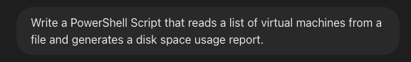
ChatGPT – PowerCLi Intro
# Variables
$vCenterServer = "your_vcenter_server"
$vmListFile = "C:\path\to\vm_list.txt" # File containing VM names, one per line
$reportFile = "C:\path\to\DiskUsageReport.csv" # Path to the report file
# Connect to vCenter Server
Connect-VIServer -Server $vCenterServer
# Initialize an array to hold the report data
$report = @()
# Read the VM names from the file
$vmNames = Get-Content -Path $vmListFile
# Loop through each VM
foreach ($vmName in $vmNames) {
# Get the virtual machine object
$vm = Get-VM -Name $vmName -ErrorAction SilentlyContinue
if ($vm -eq $null) {
Write-Host "Virtual machine '$vmName' not found." -ForegroundColor Red
continue
}
# Get the disk space usage for each hard disk
$disks = Get-HardDisk -VM $vm
foreach ($disk in $disks) {
# Calculate the disk space usage
$capacityGB = [math]::Round($disk.CapacityKB / 1MB, 2)
$usedSpaceGB = [math]::Round($disk.FreespaceGB - ($disk.CapacityGB - $disk.FreespaceGB), 2)
$freeSpaceGB = [math]::Round($disk.FreespaceGB, 2)
$usedPercentage = [math]::Round((($capacityGB - $freeSpaceGB) / $capacityGB) * 100, 2)
# Create a custom object to store the disk usage data
$reportItem = [PSCustomObject]@{
VMName = $vmName
DiskName = $disk.Name
CapacityGB = $capacityGB
UsedSpaceGB = $usedSpaceGB
FreeSpaceGB = $freeSpaceGB
UsedPercentage = $usedPercentage
}
# Add the data to the report array
$report += $reportItem
}
}
$report | Export-Csv -Path $reportFile -NoTypeInformation
Can you make the next program:
1. Lets read a list of VM’s from a file
2. Place results in a .csv file

Slide 22
Lab #4.
Write a Complicated PowerShell Program

Slide 23
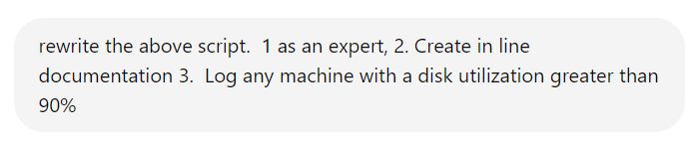
ChatGPT – PowerCLi Intro
# Connect to the vCenter server
$vCenterServer = "your_vcenter_server"
Connect-VIServer -Server $vCenterServer
# Define the path for the log file
$logFile = "C:\VM_Disk_Utilization_Log.txt"
# Clear the log file if it exists
if (Test-Path $logFile) {
Remove-Item $logFile
}
# Get all VMs in the vCenter
$allVMs = Get-VM
# Iterate over each virtual machine
foreach ($vm in $allVMs) {
# Check if the VM is powered on
if ($vm.PowerState -eq "PoweredOn") {
# Power off the VM
Write-Host "Powering off VM: $($vm.Name)"
Stop-VM -VM $vm -Confirm:$false
}
# Ensure the VM is powered off before proceeding
while ($vm.PowerState -ne "PoweredOff") {
Start-Sleep -Seconds 5
$vm = Get-VM -Name $vm.Name
}
Ask the AI to rewrite the previous Lab and alter it to:
1 write it with as an expert
2 include documentation to better understand the code
3.Create a log of all the machines that disk are more than 90% full

Slide 24
Lab #5.
Write a Web Application that calls PowerCLI

Slide 25
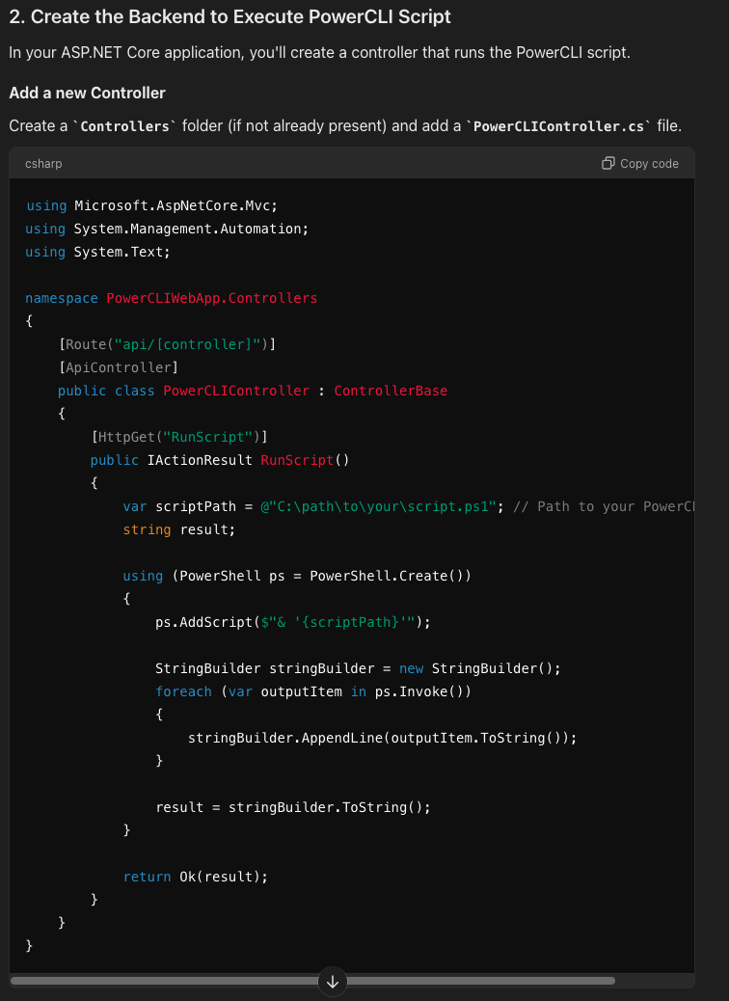

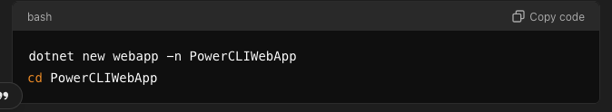
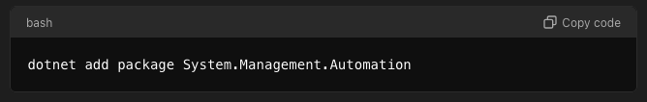
ChatGPT – Multi Language
1. Set Up the ASP.NET Core Web Application
First, create an ASP.NET Core web application:
Create a new project:
Open Visual Studio or use the .NET CLI.
Use the following command to create a new ASP.NET Core web application:
Install the required NuGet packages:
1. If using PowerShell from .NET, you need the
System.Management.Automation package:

Slide 26
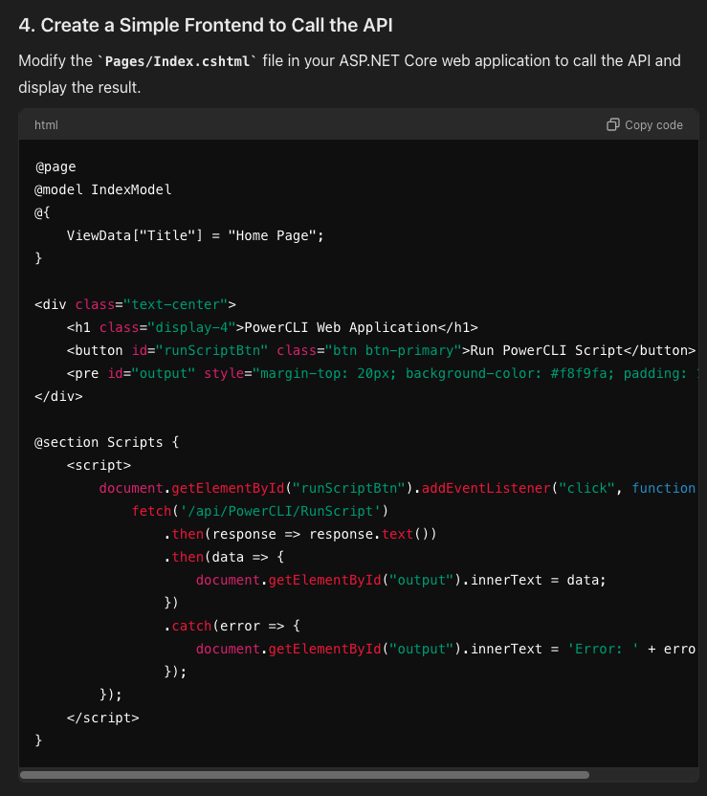
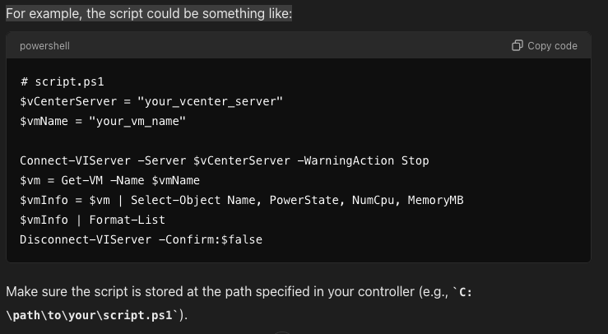
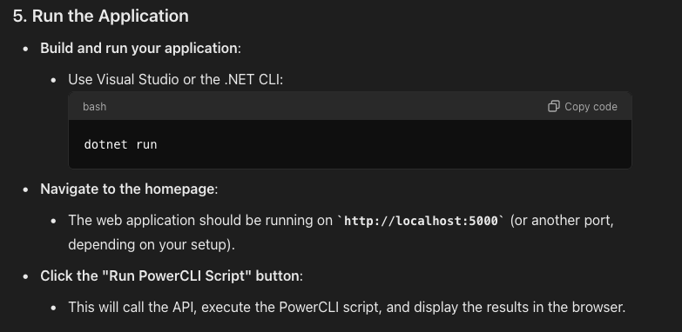
ChatGPT – Multi Language
3. Create the PowerCLI Script
For example, the script could be something like:

Slide 27
Example Ideas for Self Paced Fun
Write a PowerCLI Script that allocates share limits for Virtual Machines
Write a PowerCLI Script that snapshots a VM once week for 52 weeks
Write a PowerCLI to create a snapshot of a Virtual Machine
Write a PowerCLI to remove a snapshot of a Virtual Machine
Write a PowerCLI Script that shows all a VMs extended properities
Write a PowerCLI Example to set a custom field for a VM
Write a PowerCLI Script to vMotion from one ESX server to another if CPU first ESX server CPU usage is over 80% and second ESX is below 50%, sleep for 1 hour then check again.
Bonus: Raspberry Pi and LiveCopper ModelC BMP 280 Temperature Sensors
Write a program in python that reads temperature from a BMP280 on a Raspberry Pi
Write a program in C that used the FTDI I2C library to get the temperature from a BMP280 sensor for Windows, the FTDI chip FT232h is being used.

Slide 28
Prompt Contest
Submit the most useful prompt to an powershell App:
eric.nielsen@Broadcom.com
Be sure to include your first and last name for the wall of fame.

Slide 29
Wall of Fame
Top Submissions!

